Slide 1
Bootstrap Components
Components Based on Java Script - Day 3

Slide 2
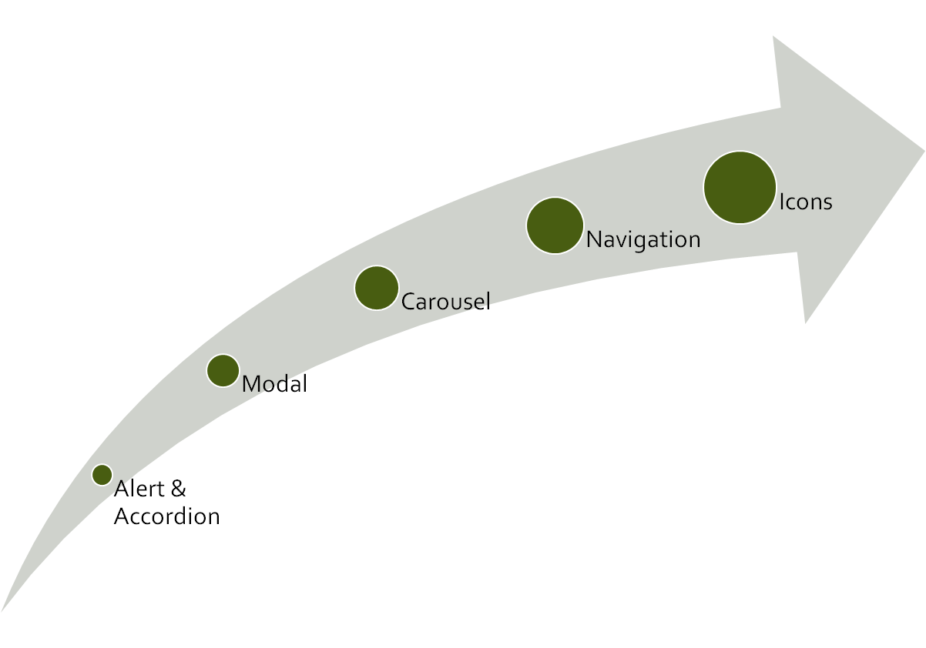
CLASS
OUTLINE

Slide 3
Modal (found under components)
<div class="modal-content"> sectionalized into : modal-header , modal-body. And modal-footer
Modal size can be controlled by adding any of the following classes to the modal-dialog div: modal-xl, modal-lg , modal-sm
Please refer to the documentation for more carousel options
Exercise:
On your page, create a button labeled “Sign Up” and a link labeled “terms and conditions” Using the modal, when a user clicks on the button, launch a modal titled ‘registration form’ that contains a Registration form. When a user clicks on the link, load Terms and Condition in a modal

Slide 4
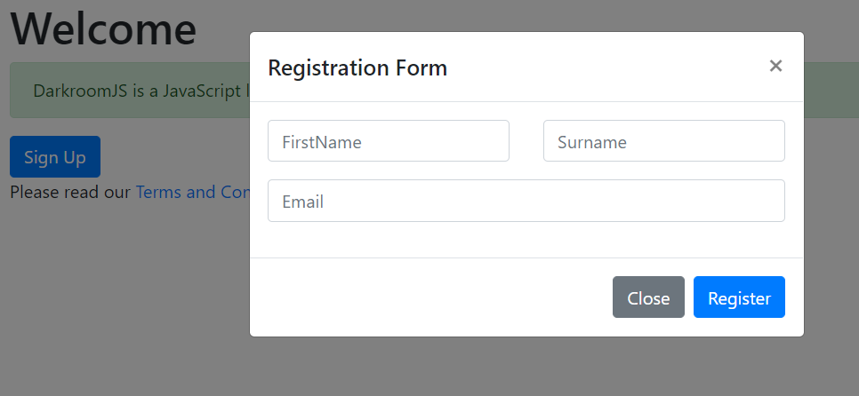
When sign up button is clicked…

Slide 5
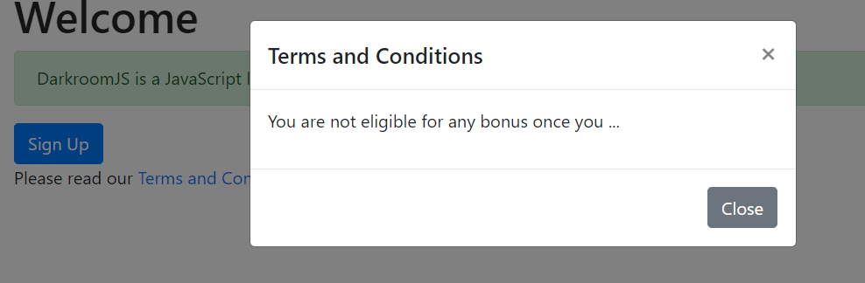
When Terms and Conditions link is clicked…

Slide 6
Navigation found under Components
Used for creating a responsive menu
Importantly, it has the ability to toggle and collapse when viewed on a mobile device, it makes use of the class collapse.navbar-collapse for grouping and hiding navbar contents by a parent breakpoint.
It makes use of flexbox, therefore you can apply common flexbox rules such as align-items, justify-content etc
You can also apply your own stylings to change the background and/or font colors.
The classes navbar-light and bg-light are largely responsible for the colors. You can remove the classes while applying your own style
CLASSWORK Customize the navigation bar to suit your favourite color theme

Slide 7
More
Components
Accordion: can be used to save space
Offcanvas:can be used for social media menus, shopping cart, minor menus etc

Slide 8
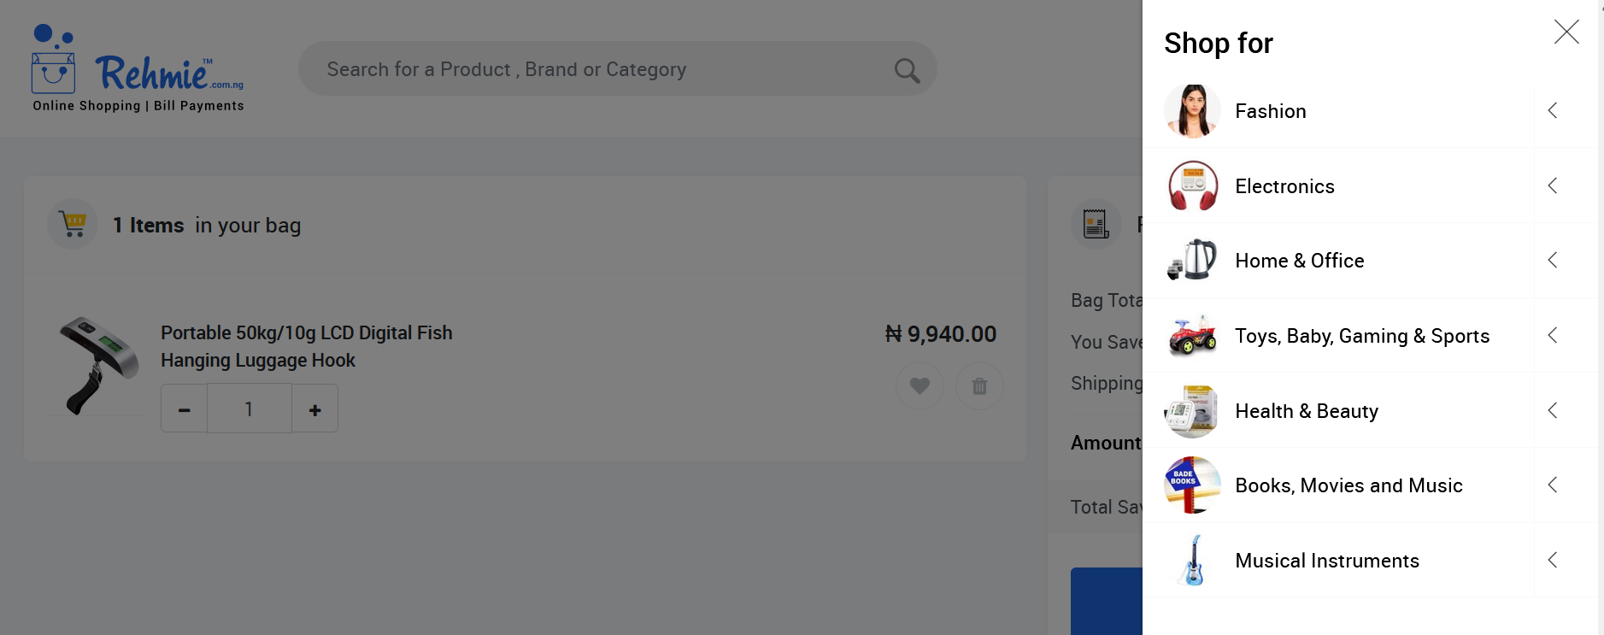
See Example Off canvas usage

Slide 9
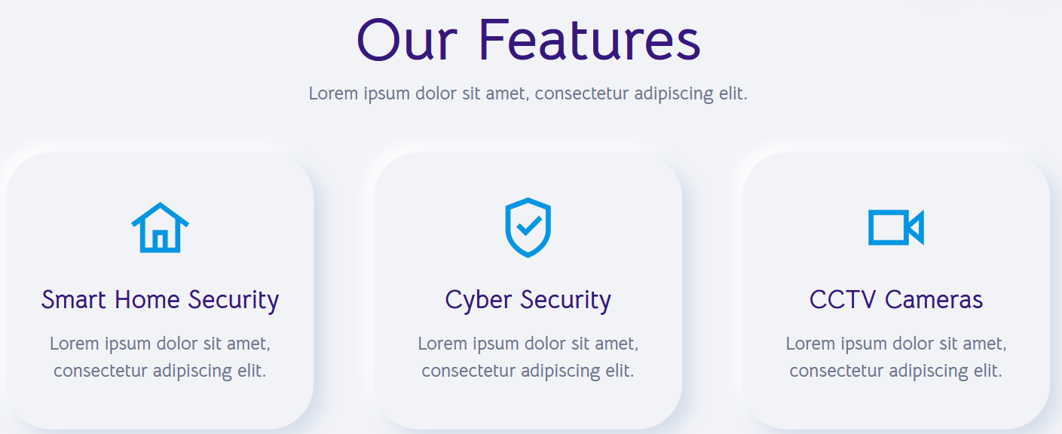
Using Icons on your Website

Slide 10
Making Your website more beautiful with Icons
Icons add meaning to your web contents. – Easy to understand without reading any manual!
Icons simplify your website
When Using icons, ensure that the icon conveys the meaning.
Icons always have pre-defined dimension**, you can get images for icons freely online
  https://findicons.com
  https://iconfinder.com
  https://www.freeiconspng.com/
  https://flaticon.com/
Notes:
** Most icons have dimensions in 8px, 16px, 24px, 32px, 48px and 64px

Slide 11
Making Your website more beautiful with Icons
Icons are different from other images because of their dimension and disk size, and also have transparent backgrounds (png)
  You can remove the background from a jpeg (non-transparent) image online (https://remove.gb)
  You can compress your images on (https://compresspng.com/ , https://compressjpg.com/ ) without compromising the quality
Icons always have pre-defined dimension of 8px, 16px, 24px, 32px, 48px and 64px
Notes:
** Most icons have dimensions in 8px, 16px, 24px, 32px, 48px and 64px

Slide 12
Monochromatic Icons and Symbols
Image-based icon still takes some amount of disk space, monochromatic icons and symbols which are based on css styles are now in use – conserves space
These types of icons do not make use of images but use css along other techniques to draw shapes and symbols that are commonly used on web pages.
Examples of such icons are:
  Font awesome
  Glyphicons
  Open iconic

Slide 13
Using Icons in your website-
Bootstrap recommends icons from Iconic and Octicons (https://useiconic.com/open/) and (https://octicons.github.com/ ) respectively. (Download the package from the respective website)
Other sources of monochromatic icons is Font Awesome https://fontawesome.com/icons?d=gallery&m=free

Slide 14
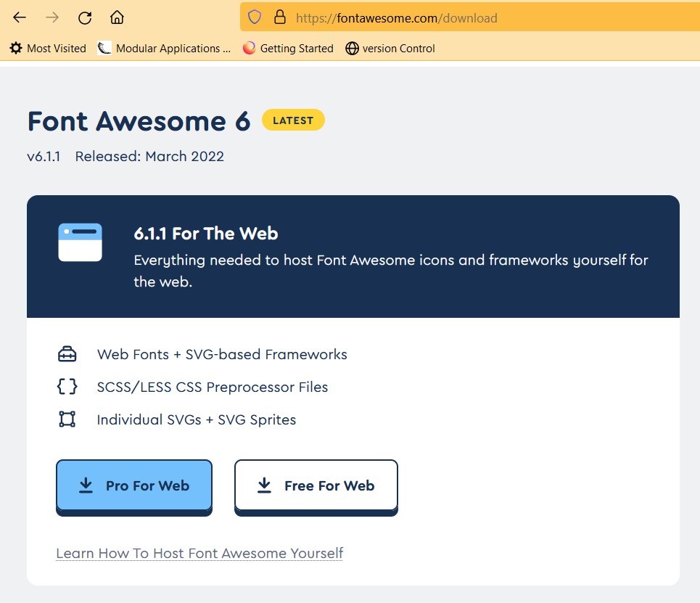
Font Awesome Usage
Visit https://fontawesome.com/download to download, extract it to your project folder

Slide 15
Font Awesome Usage
The /css/all.css file contains the core styling plus all of the icon styles that you’ll need when using Font Awesome. The /webfonts folder contains all the typeface files that the above CSS references and depends on.
Copy the entire /webfonts folder and the /css/all.css into your project’s static assets directory (or wherever you prefer to keep front end assets or vendor stuff).
Add a reference to the copied /css/all.css file into the <head> of your webpage.
Add the following to your head section: <link href="css/all.css" rel="stylesheet">
Notes:
https://fontawesome.com/download

Slide 16
Font Awesome Usage
It has 3 categories namely: regular, solid light and brand.
Generally, an icon from font awesome is positioned on your web page using any inline HTML tag such as span. By convention, the <i> tag is also used.
2 classes are required fa-* and fa-<name> (* may regular, solid, light and brand respectively) and name is that assigned to the icon by font awesome. Example <span class=“fa-regular fa-home”></span> will create a solid home icon.
An advantage of this type of icon over image icons is the fact that it can be included in other tags such as button

Slide 17
Font Awesome Usage
  Extract the folder and place it within your project
  In the head section, include the link to the external css file as follows:
  <link href=‘fontawesomefolder/fonts/css/ fontawesome.css’ rel=‘stylesheet’>
  In the body section (button, p, heading etc where you want to use it) include as follows:
  <span class=‘fa-regular fa-name’></span>
  where name is the name of the icon
  By convention, the <i></i> tag is used for placing icons.
  You can apply the color, font-size, font-style to style your icons.

Slide 18
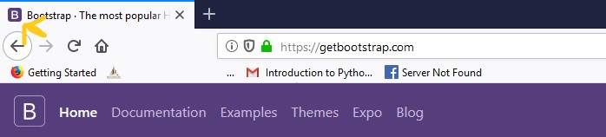
Favicon
See the arrow pointing to the image at the top left corner ; the image is called favicon

Slide 19
Favicon
A favicon, also known as a shortcut icon, or bookmark icon, is a file containing one or more small icons, associated with a particular website or web page. It usually shows in the title bar of websites
You can generate favicon freely from an image on this site https://www.favicon-generator.org/ (usage also included)
You can include favicon on your webpage using the link tag as follows:
<link rel="icon" href="favicon.ico"> other varieties exist (check the notes)
The above favicon generator generates varying sizes of icons and their respective usages
Notes:
<link rel="icon" href="favicon.png" sizes="16x16" type="image/png">

Slide 20
Other Bootstrap Components
https://getbootstrap.com
Progress bar
Cards
Nav-pills
Popovers
etc

Slide 21
WEEK THREE MINI PROJECT
See requirements on the next slide

Slide 22
Requirements for a Personal Website
See yourself as an established software developer with a couple of skills and portfolio. Develop a convincing and responsive personal website to showcase these skills and portfolio for possible employment and other business opportunities.
DUE FOR REVIEW: Monday
Submission : via Github (Next Lesson)

Slide 23
KEEP CODING!
Imagine and create…

